Slide 1
How Do I create a multimedia presentation?
Software System Development

Slide 2
What do I need?
4 Short Multimedia Presentations
Maximum length 4 min
9 topics to choose from
The assumption is that you should show HOW the specific topic is being used within the software development exercise (Game Café System)

Slide 3
Tools
Hardware: Computer (laptop or otherwise) with built-in Microphone
Software: PowerPoint (or equivalent)
Slides: 4 – 8 slides are recommended
Content: Diagrams and/or pictures (use .png format for diagrams, .jpg for photos, if necessary), supported with brief text. Don’t use lots of photos.
Script: You should prepare your script carefully
Practice: Don’t try this for the first time on the day of submission

Slide 4
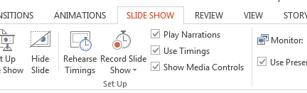
Using PowerPoint
Version 1
Create your set of PowerPoint slides
Click on Slide Show
Select Record Slide Show
Read Script and change slide as normal
You can change the order of the slides later if you wish

Slide 5
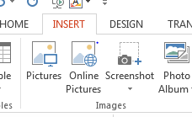
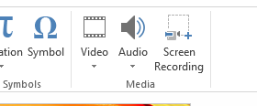
Using PowerPoint
Version 2
Create each slide individually or as a sequence
For each slide click Insert and select Audio Insert
Read your script for that slide
Edit your slide show

Slide 6
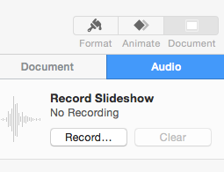
Using Keynote
Create your Keynote Slides
Click on Document on top right
Then click Record
You can import audio files instead.
Export your presentation as a PowerPoint file (.pptx) since Keynote files are larger than PowerPoint.
You can edit your presentation as required.

Slide 7
Very Important
Review your presentation before submission
Do NOT export the PowerPoint presentation as a video, but leave it as a .pptx file. (This is because the file size increases when exported)
Make sure your average file size is less than 10Mb.
Upload directly into the appropriate Solent Online Learning upload assignment page
You can upload 4 PowerPoint files (plus your script)
Once you have submitted your files, click “Submit for Marking”.

